Slide 1
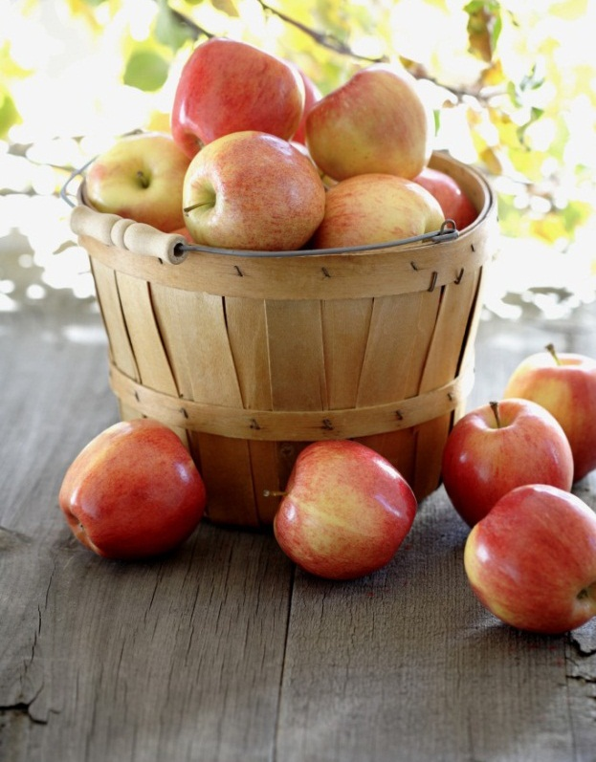
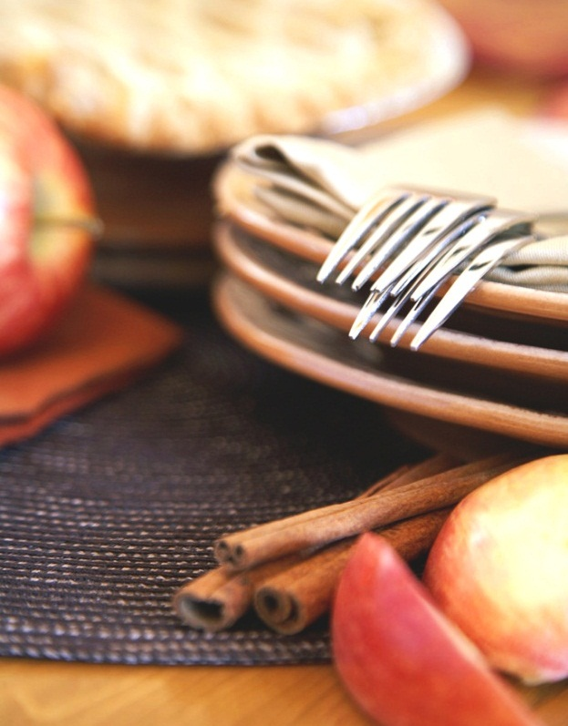
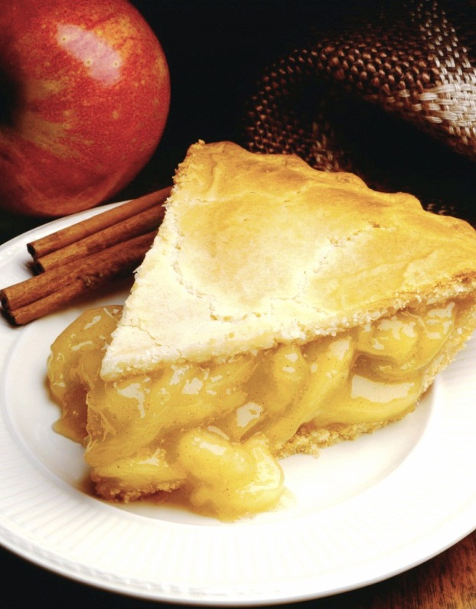
🍔Online Food Delivery🍕
Notes:
NOTE: To replace a picture, just select and delete it. Then use the Insert Picture icon to replace it with one of your own!

Slide 2
Project Members
Name: Daniel Deep Pereira
Name: Nafis Nawal Nahiyan
Name: Saurov Sikder

Slide 3
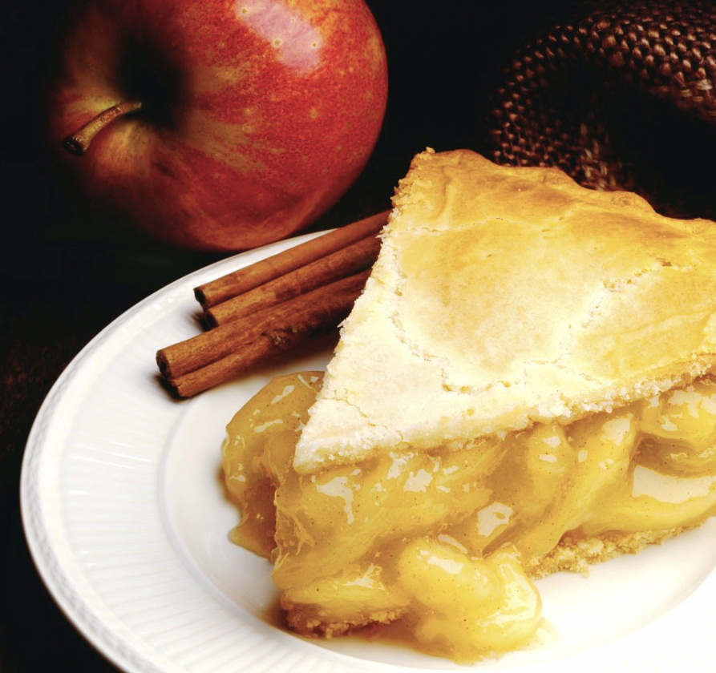
EAT AND ENJOY 🍟🍔🌭🍕🌮

Slide 4
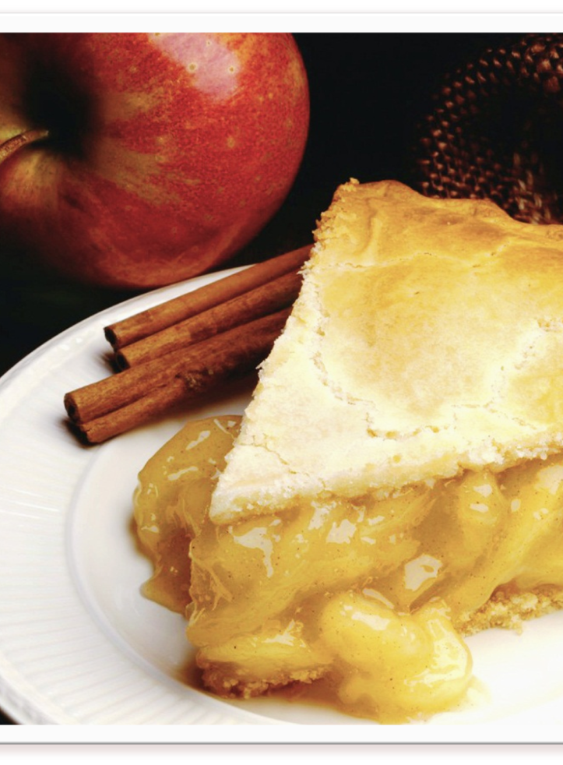
Introduction
We have built a ADT to simulate Online Food Delivery software. Our objective was to build a cpp program based on data structure which can deliver foods to customers . It can also store foods in the inventory.

Slide 5
Project Resolution
Different kinds of food with it’s own items.
The customers have to organize as FCFS basis.
Reserve different kinds of foods’ detail in linked list.
Store the information of customer’s order in queue.
Store the information of ordered food of per customer in stack.
Build report that will show the daily and monthly selling reports of foods.

Slide 6
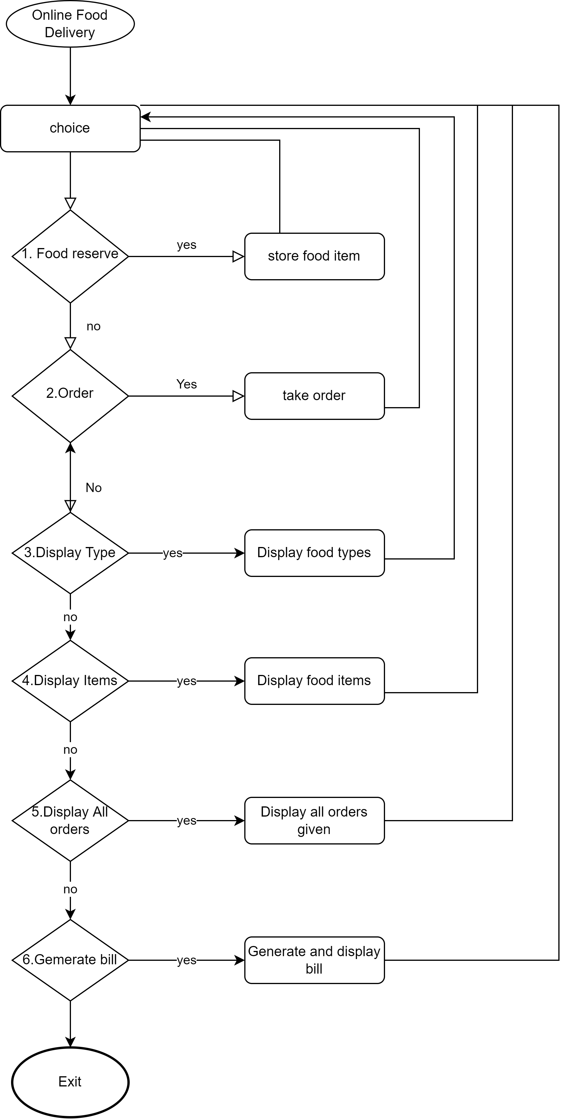
Flowchart

Slide 7
Classes
Type
FoodType
Item
FoodItem
OrderItem
OrderItemStack
Order
FoodOrder

Slide 8
Data Structures
Single linked list
Stack
Queue

Slide 9
Features
Food Reserve
Take customer order
Display Food Types
Display Food Items
Display All Orders
Generate Bill

Slide 10
Limitations
In our program, we did not implement the function to search the person who gave the order using the order (backtracking). Though we have designed in such a manner that we can easily declare a function to do so.
This program can not store the data permanently.
Daily and monthly selling report are not shown.

Slide 11
Future work
Search customers using order.
Permanent inventory.

